Slide 1
Data visualization in ggplot2 (part 2)
Workshop #5
Calvin Munson

Slide 2
(And scales!)

Slide 3
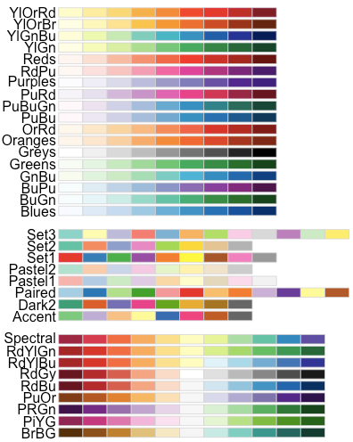

Slide 4
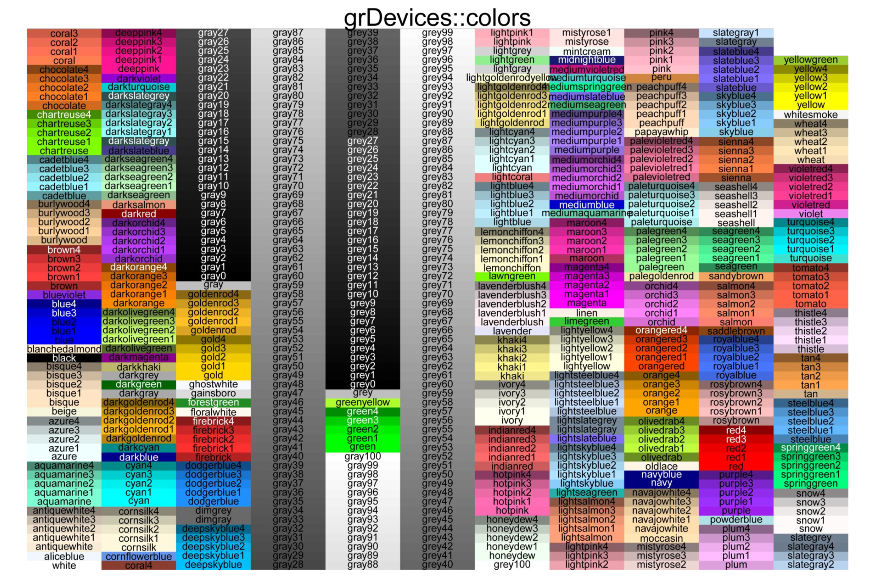

Slide 5
